Slide 1
Basic Statistics Central Tendency Measures

Slide 2
Topics
Mean/Average’s
AM/GM/HM
Quadratic Mean
Weighted Mean
Generalized Mean
Function Average
Mode
Median
Quartiles
Cross Tab
Scatter Plot
Quantiles

Slide 3







Mean or Average
An average is a single value that attempts to describes a group
Arithmetic Mean or Simple Average
Geometric Mean
Harmonic Mean
Quadratic Mean
Weighted Mean
Generalized Mean
Function Average

Slide 4
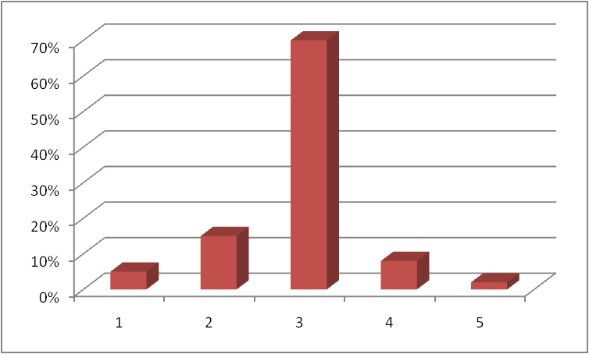
Mode
The most frequently occurring value is Mode
Mode may not necessarily be unique
Makes sense for nominal data (Non Numerical)
3 is the Mode for this data since Maximum Volume occurs here

Slide 5
Median
Described as the value separating lower half of a distribution from the upper half
For odd no of observations the value occurring at the center is the median when values are arranged in order
For even no of observations the AM of the two values occurring at the center is the median when values are arranged in order
Median is AM of 4 and 6 = 5
Median is 4

Slide 6
Summary
Measure | Advantages | Disadvantages
Mean (Sum of all values ÷ no. of values) | ∗ Best known average ∗ Exactly calculable ∗ Make use of all data ∗ Useful for statistical analysis | ∗ Affected by extreme values Can be absurd for discrete data (e.g. Family size = 4.5 person) ∗ Cannot be obtained graphically
Median (middle value) | Not influenced by extreme values Obtainable even if data distribution unknown (e.g. group/aggregate data) Unaffected by irregular class width ∗ Unaffected by open-ended class | Needs interpolation for group/ aggregate data (cumulative frequency curve) May not be characteristic of group when: (1) items are only few; (2) distribution irregular ∗ Very limited statistical use
Mode (most frequent value) | ∗ Unaffected by extreme values ∗ Easy to obtain from histogram ∗ Determinable from only values near the modal class | Cannot be determined exactly in group data ∗ Very limited statistical use

Slide 7
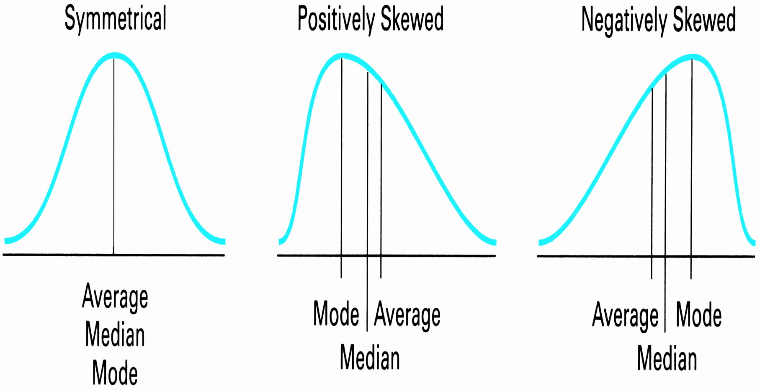
Relationship Among the Measures of Central Tendency

Slide 8
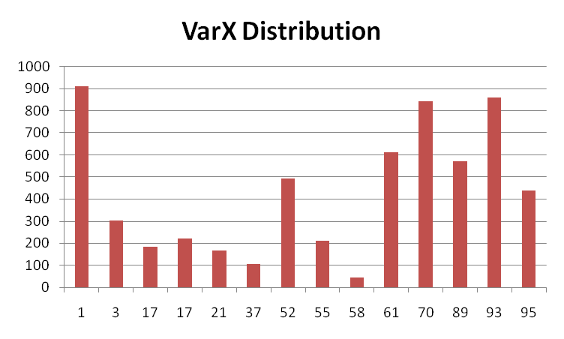
Quartiles
If all the observations are arranged in order and dived by three values so that four groups so formed have equal no of observations then either of these three values are called quartiles
Interquartile Range
Q1 – Lower Quartile
Q2 – Middle Quartile
Q3 – Upprr Quartile

Slide 9
Cross Tab
A cross tabulation or contingency table shows the joint distribution of two or more variables usually presented in a matrix like format
Extremely Intuitive way of data understanding and interpretation
 | Salary <=$100K | Salary > $100K
Undergraduate | 65% | 35%
Post Graduate | 50% | 50%
Phd | 40% | 60%
MBA | 20% | 80%
Engineer | 70% | 30%

Slide 10
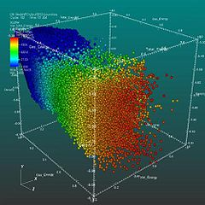
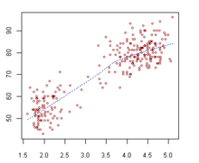
Scatter Plot
A Scatter Plot is a means of data visualization by means of Cartesian coordinates on a graph
A scatter plot may contain information of multiple dimensions
3 dimensions – spatial location
1 dimension – color coding
1 dimension – radii of the point at the spatial location

Slide 11
Quantiles
The 2-quantile is called the median
The 3-quantiles are called tertiles or terciles → T
The 4-quantiles are called quartiles → Q
The 5-quantiles are called quintiles → QU
The 9-quantiles are called noniles → NO
The 10-quantiles are called deciles → D
The 12-quantiles are called duo-deciles → Dd
The 20-quantiles are called vigintiles → V
The 100-quantiles are called percentiles → P
The 1000-quantiles are called permillages → Pr

Slide 12
Assignments
Calculate average of 12,20,45,67,85,45
Calculate weighted average of above numbers using weights 10,20,30,40,50,60
How does the mean change and why ?
A credit bureau score lies between 350 and 850. Generate a sample of 1000 accounts score. Find the average bureau score.
Variations in the score are smooth and not over 50 points in a month, Show that though each account changes scores month over month the average remains the same.
Calculate the 1st and 3rd quartile month over month on these scores and show interquartile range every month

Slide 13
Assignments
Average of 3 numbers is 20. One number is doubled and the average changes to 25. Find the average of the remaining two numbers.
One person drove a semi circle of radius 5kms at a speed of 60kmph and returned directly to the starting position at a speed of 40kmph. What is the average speed over the journey ?

